Slide 1
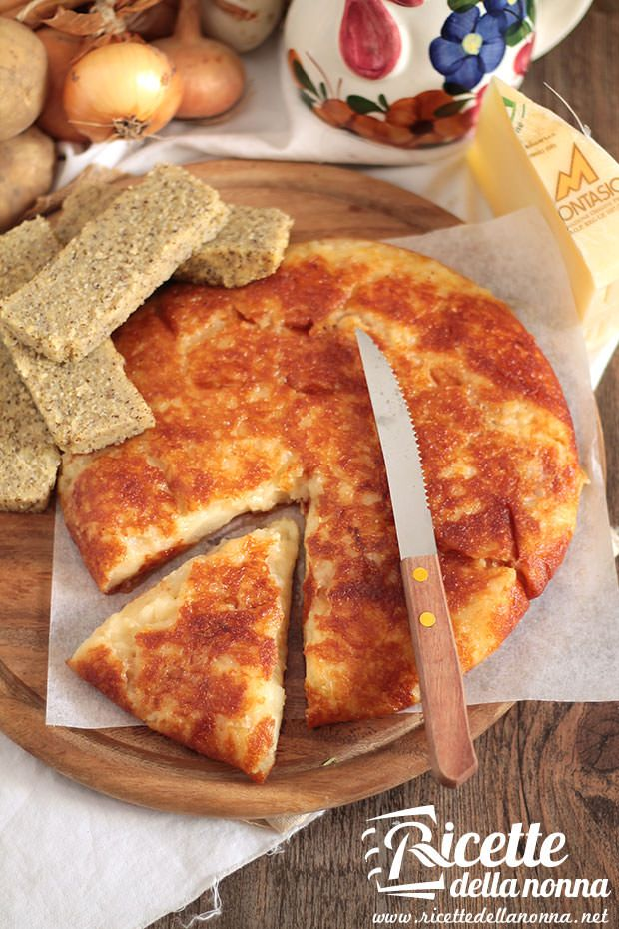
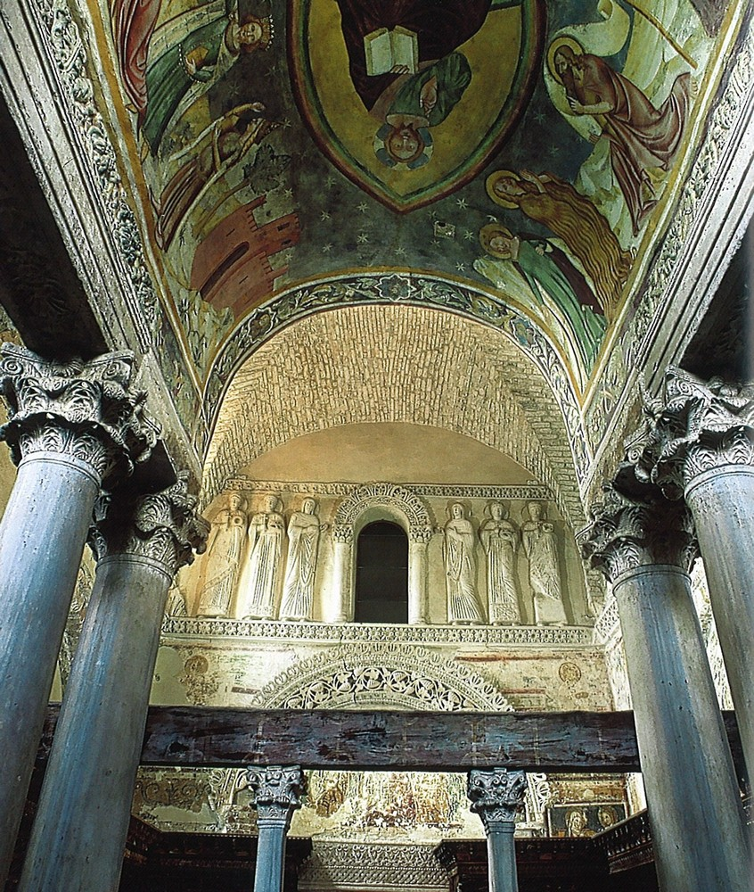
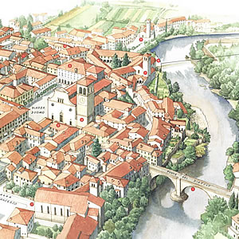
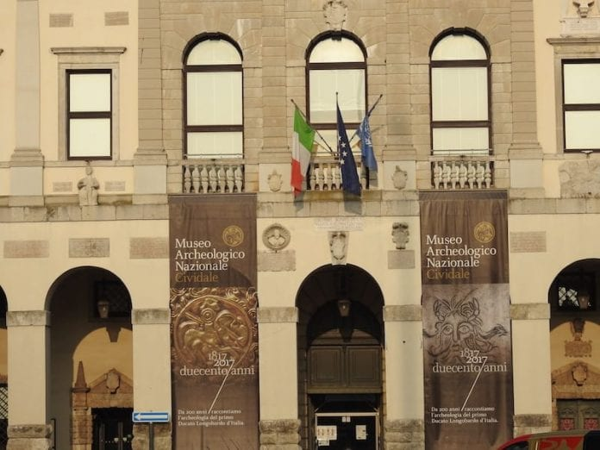
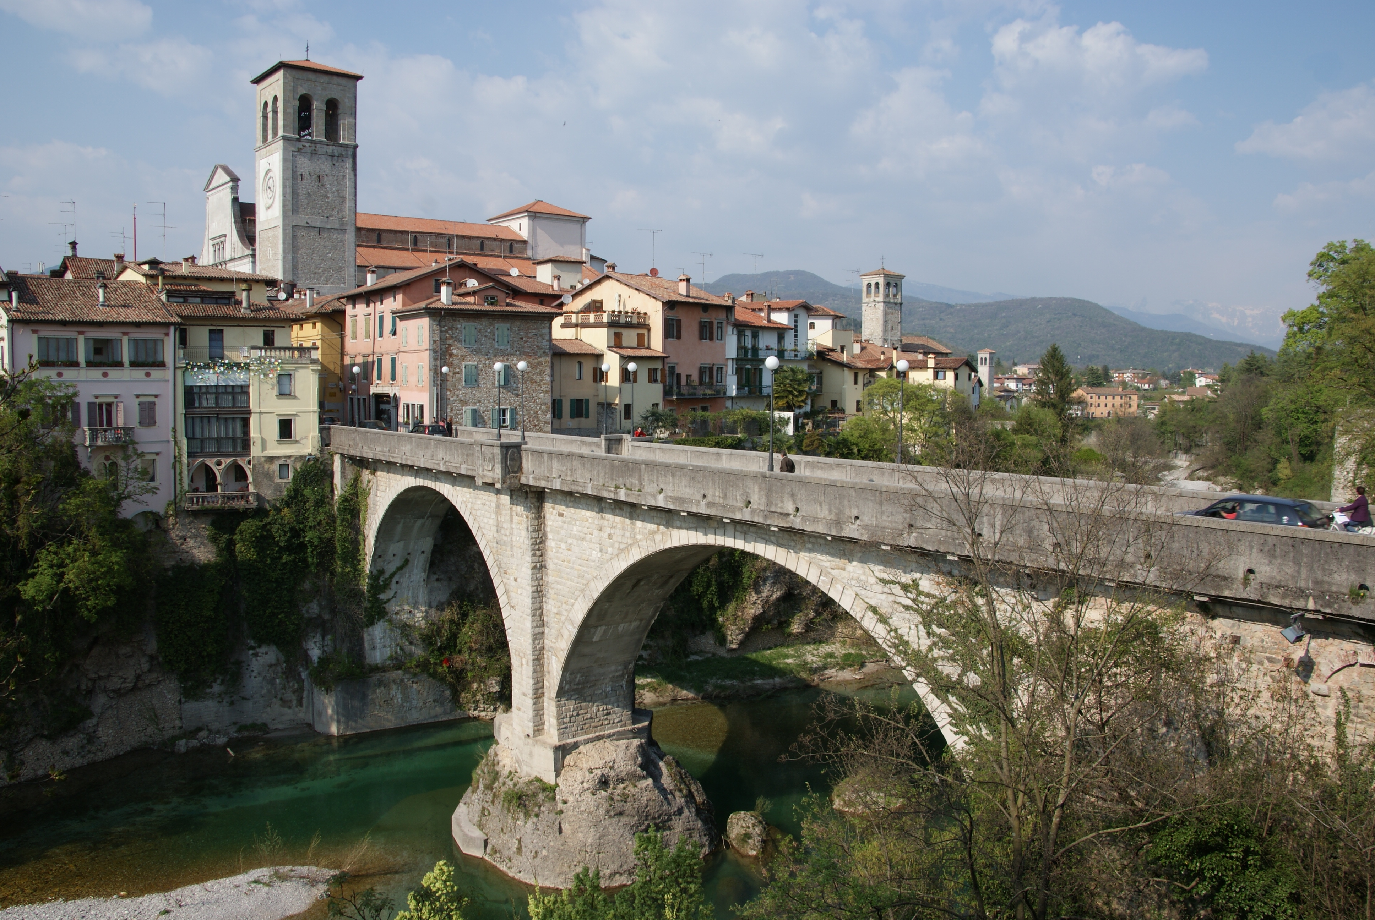
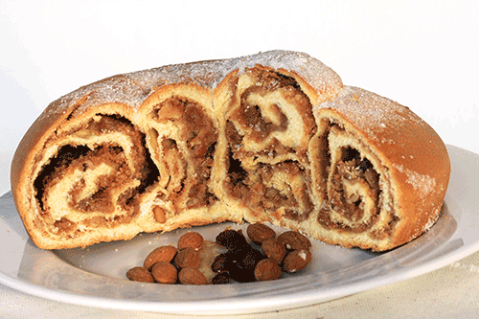
LOMBARD TEMPLE
The temple is one of the main attractions in Cividale, now part of a set of buildings which is on the UNESCO World Heritage List. Itis a landmark of the passage of Longobards in Friuli.
visiting Cividale visiting Cividale visiting Cividale
FRICO
This is a typical Friuli’s dish, it is made of potatoes, cheese, onions. You can have it with polenta (another typical dish of the region). You can enjoy a delicious frico in the famous restaurant «Al Monastero» .
NATIONAL MUSEUM OF ARCHEOLOGY
Founded in 1817, the museum displays the «Altar of Rachtis» and many other Lombard artworks.
Worth a visit!!!
DEVIL’S BRIDGE
It was built in 1442. It is made of stone. The legend tells of a Devil, who built the bridge in exchange for the soul of the first creature that would walk on the same bridge.
GUBANA
The cake is made of raisins, pinenuts, grappa, and dried fruit. You can find it in the historical pastry Cattarossi.
.

Slide 2
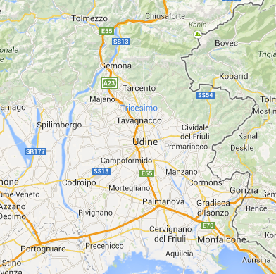
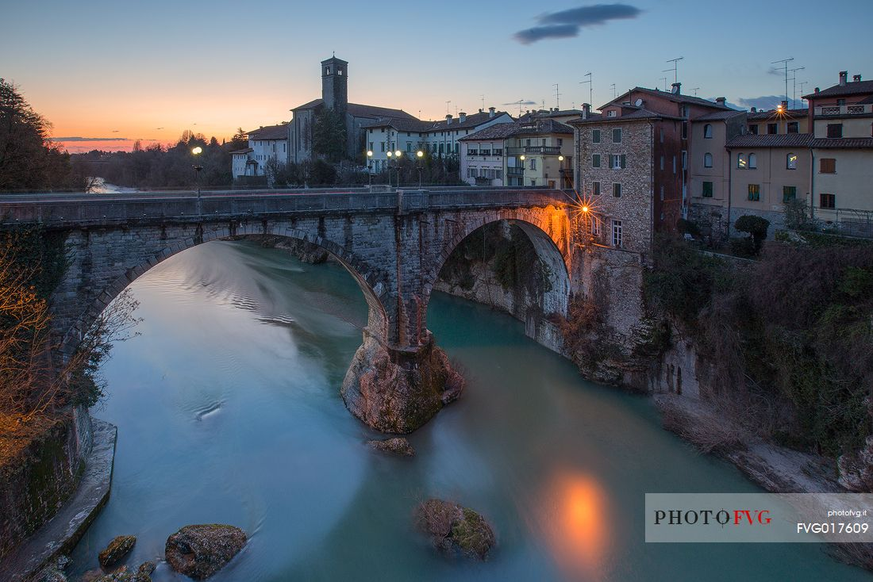
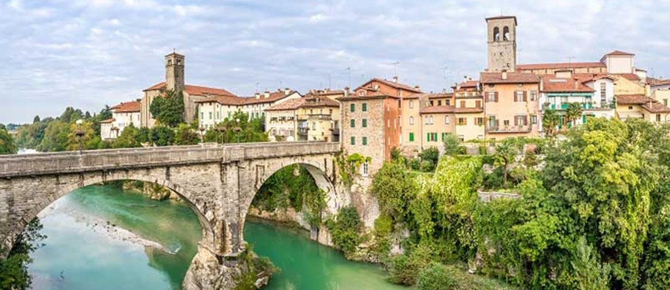
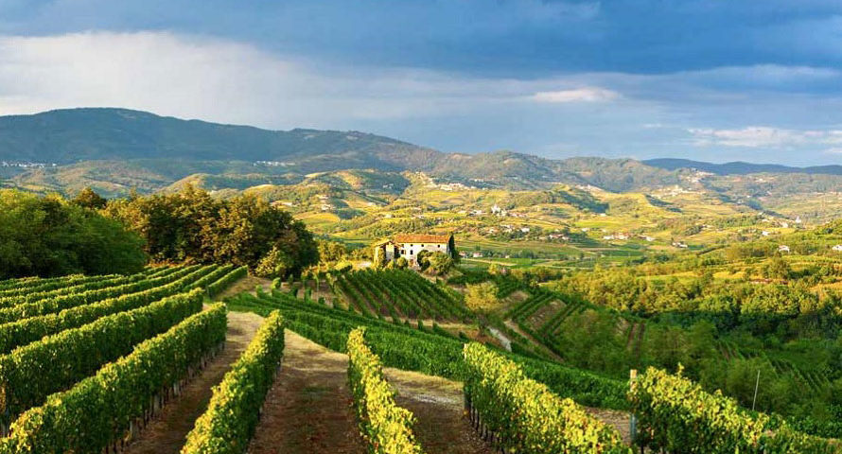
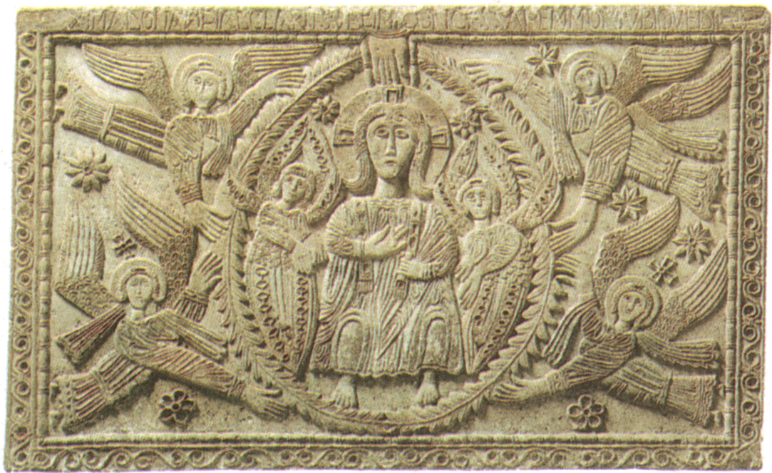
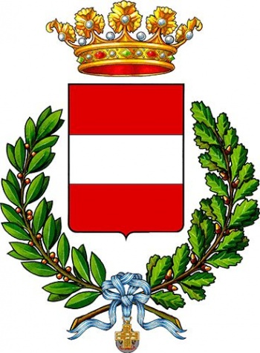
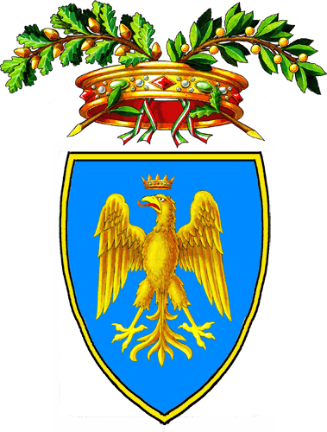
 |  | k
Travelling to Cividale
Cividale is a small town in the North-East of Italy, in Friuli-Venezia Giulia.
By car: close to the A23 (exit Udine North). Cividale is easily accessible from all parts of Friuli.
By rail: Cividale rail station is only 25 minutes drive from Udine. The railway station is a 10 minute walk to the town centre.
By bus: Cividale is well connected with all services to Udine. There is a helpful jouney planner at www.saf.ud.it
A DAY-TRIP IN
CIVIDALE
Coordinated by: Lucia Dri
Written by: Enrico Savorgnan
Graphics by: Adele Tonelli
Pictures by: Joele Schiff

